Slide 1
Production Scheduling Optimization

Slide 2
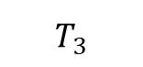
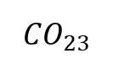
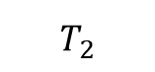
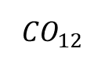
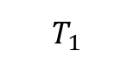
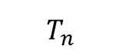
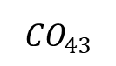
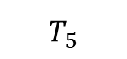
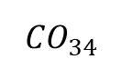
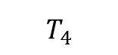
Problem Statement
$$T_{1}$$
$$T_{2}$$
$$T_{3}$$
$$T_{4}$$
$$T_{5}$$
$$T_{n}$$
P1
P2
P3
P4
P3
P2
$${CO}_{12}$$
$${CO}_{23}$$
$${CO}_{34}$$
$${CO}_{43}$$
Factor | CO Time | Inventory Cost
Increase in frequency of changeover | Increase | Decrease
Decrease in frequency of changeover | Decrease | Increase
From-To product combination | Increase/decrease based on product combination | -
What to produce?
When to produce?
How much to produce?

Slide 3
Scopes & Assumptions
System Under Consideration: AL- CHEWY PROCESSING LINE
Total 9 SKUs (main flavors: ALMOND,PEANUTS, FRT NUT, CHOC PRETZEL NUT, REESES, GOLDEN GRAHAMS)
MILP Model is developed with objective to minimize total cost
Total Cost = CO Cost + Inventory Holding Cost + Penalty Cost + Overflow Cost
CO Cost = CO Time(day) * Line Rate (EA/day) * Product Cost * Profit Margin ($/unit $)
Inventory Holding Cost = 9% per year per unit $ of product * Excess Inventory * product cost
Penalty Cost = Profit Margin * Inventory Shortage
Overflow Cost = Profit Margin * Excess Inventory above Max DOS
Cost of single product = 1$
Excess Inventory = Current Inventory – Safety Stock
Inventory Shortage = Safety Stock – Current Inventory
Considering product will run at least a day if it starts running

Slide 4
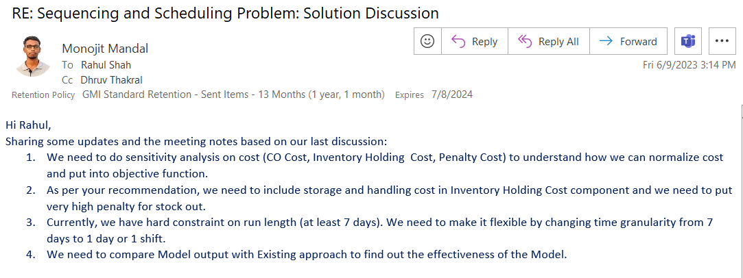
Follow Ups

Slide 5
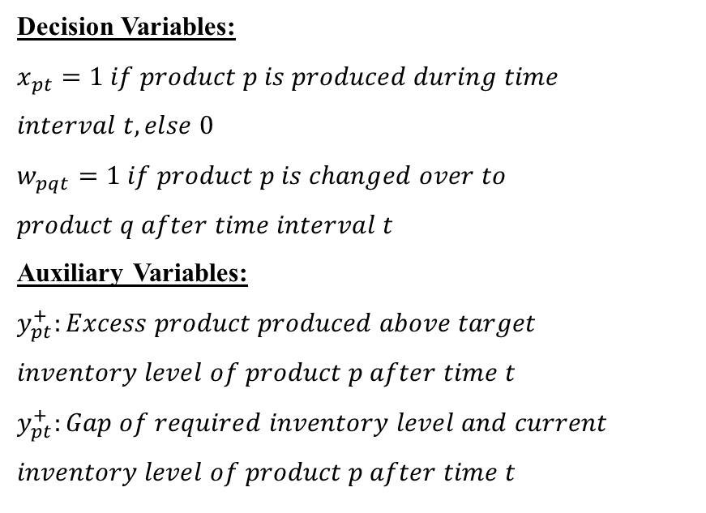
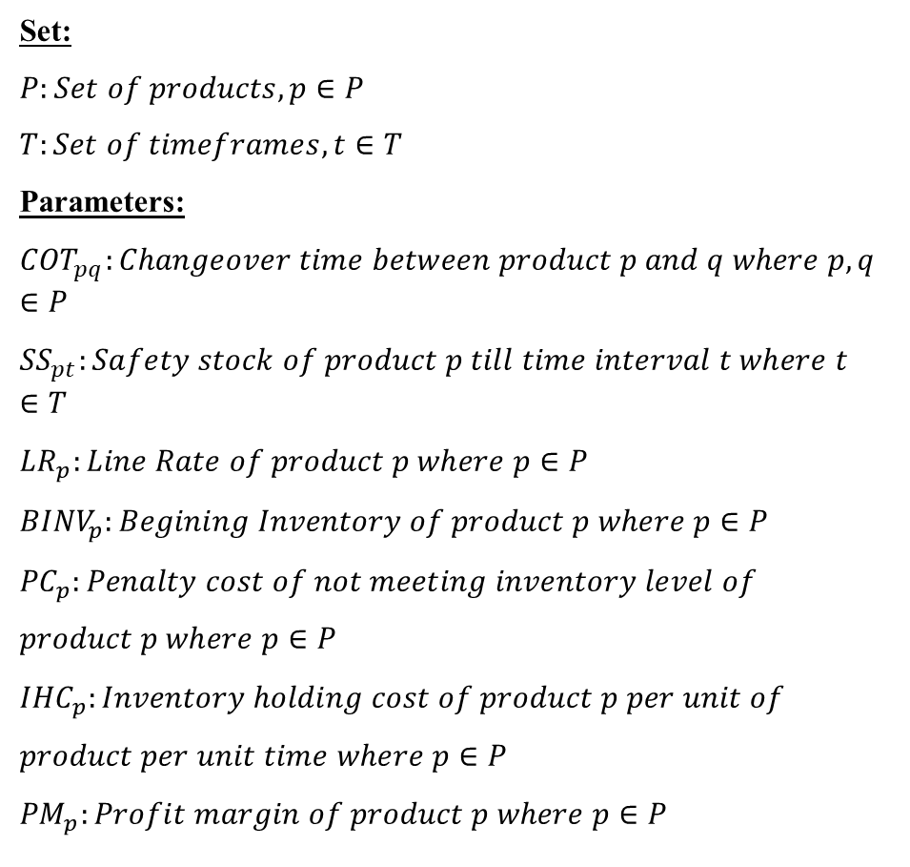
Parameters & Decision Variables
Set:
$$P:Set of products, p∈P$$
$$T:Set of timeframes, t∈T$$
Parameters:
$${COT}_{pq}:Changeover time between product p and q where p,q∈P$$
$${SS}_{pt}:Safety stock of product p till time interval t where t∈T$$
$${LR}_{p}:Line Rate of product p where p∈P$$
$${BINV}_{p}:Begining Inventory of product p where p∈P$$
$${PC}_{p}:Penalty cost of not meeting inventory level of$$
$$product p where p∈P$$
$${IHC}_{p}:Inventory holding cost of product p per unit of$$
$$product per unit time where p∈P$$
$${PM}_{p}:Profit margin of product p where p∈P$$
Decision Variables:
$$x_{pt}=1 if product p is produced during time$$
$$interval t, else 0$$
$$w_{pqt}=1 if product p is changed over to$$
$$product q after time interval t$$
Auxiliary Variables:
$$y_{pt}^{+}:Excess product produced above target$$
$$inventory level of product p after time t$$
$$y_{pt}^{+}:Gap of required inventory level and current$$
$$inventory level of product p after time t$$

Slide 6
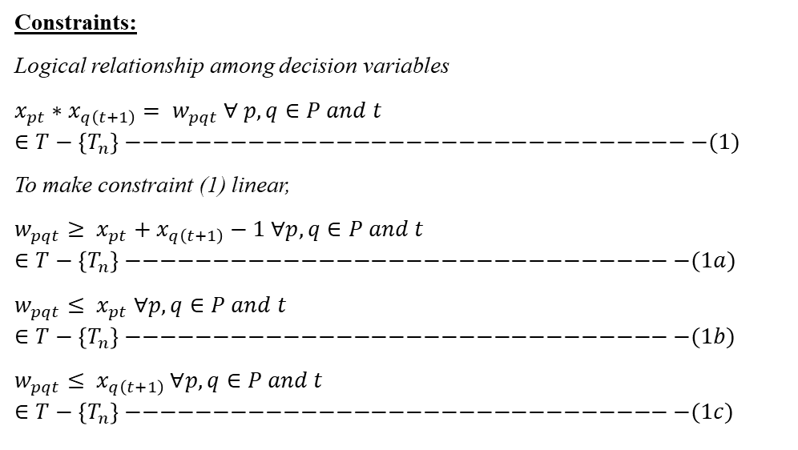
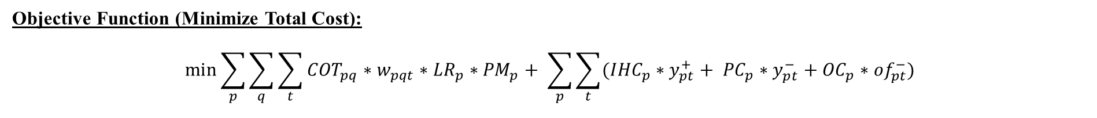
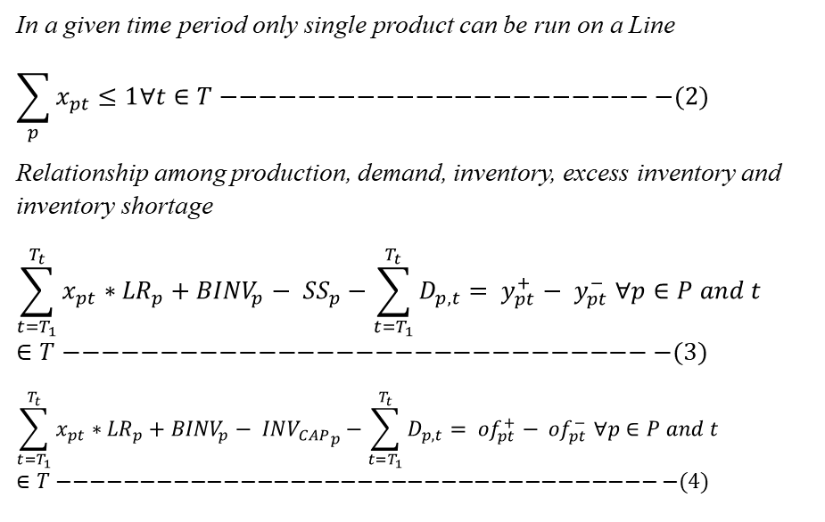
MILP Problem Formulation
Objective Function (Minimize Total Cost):
$$\min{\sum_{p}{\sum_{q}{\sum_{t}{{COT}_{pq}∗w_{pqt}∗{LR}_{p}∗{PM}_{p}}}}}+ \sum_{p}{\sum_{t}{({IHC}_{p}∗y_{pt}^{+}+ {PC}_{p}∗y_{pt}^{−}+{OC}_{p}∗{of}_{pt}^{−})}}$$
CO Cost
Inventory Cost
Constraints:
Logical relationship among decision variables
$$x_{pt}∗x_{q\left(t+1\right)}= w_{pqt} ∀ p,q∈P and t∈T−\left\{T_{n}\right\}−−−−−−−−−−−−−−−−−−−−−−−−−−−−−−−−−(1)$$
To make constraint (1) linear,
$$w_{pqt}≥ x_{pt}+x_{q\left(t+1\right)}−1 ∀p,q∈P and t∈T−\left\{T_{n}\right\}−−−−−−−−−−−−−−−−−−−−−−−−−−−−−−−−(1a)$$
$$w_{pqt}≤ x_{pt} ∀p,q∈P and t∈T−\left\{T_{n}\right\}−−−−−−−−−−−−−−−−−−−−−−−−−−−−−−−−(1b)$$
$$w_{pqt}≤ x_{q\left(t+1\right)} ∀p,q∈P and t∈T−\left\{T_{n}\right\}−−−−−−−−−−−−−−−−−−−−−−−−−−−−−−−−(1c)$$
In a given time period only single product can be run on a Line
$$\sum_{p}{x_{pt}}≤1∀t∈T−−−−−−−−−−−−−−−−−−−−−−−(2)$$
Relationship among production, demand, inventory, excess inventory and inventory shortage
$$\sum_{t=T_{1}}^{T_{t}}{x_{pt}∗{LR}_{p}}+{BINV}_{p}− {SS}_{p}−\sum_{t=T_{1}}^{T_{t}}{D_{p,t}}= y_{pt}^{+}− y_{pt}^{−} ∀p∈P and t∈T−−−−−−−−−−−−−−−−−−−−−−−−−−−−−−−(3)$$
$$\sum_{t=T_{1}}^{T_{t}}{x_{pt}∗{LR}_{p}}+{BINV}_{p}− {INV_{CAP}}_{p}−\sum_{t=T_{1}}^{T_{t}}{D_{p,t}}= {of}_{pt}^{+}− {of}_{pt}^{−} ∀p∈P and t∈T−−−−−−−−−−−−−−−−−−−−−−−−−−−−−−−−−−−−−(4)$$

Slide 7
Cost Sensitivity Analysis
Assumptions:
Average Line Rate: 1.5 M EA/day
Average Profit Margin of products: 35%
Beginning Inventory = Safety Stock
Product Cost/EA = 1 $
Interest Rate= 9%
If we observe 1 hr of changeover in a year,
Amount of product loss = Line Rate * CO Time = 1.5 M*1/24 = 62,500 EA
CO Cost= Amount of production loss * Product Cost * Profit Margin = 62,500*35% = $ 23,000
Amount of inventory shortage = Line Rate * CO Time = 1.5 M*1/24 = 62,500 EA
Penalty Cost = Amount of inventory shortage * Product Cost * Profit Margin= 62,500 *35% = $ 23,000
Similarly, if we did not observer CO, we could produce product during the time and hold it for a year,
Excess Inventory above Safety Stock = Line Rate * CO Time = 1.5 M*1/24 = 62,500 EA
Holding Cost = Excess Inventory above Safety Stock * product cost * Interest Rate = 62,500*1*9% = $ 4,300
Penalty Cost and CO Cost are 5 times higher than Inventory Holding Cost

